Slide 1
Macroecology and Biogeography
Latitudinal Gradients in Biodiversity
By Varinka Pastrana, Mahmud Gurbanzade, Nate Harrison,
San Khin Chuu

Slide 2
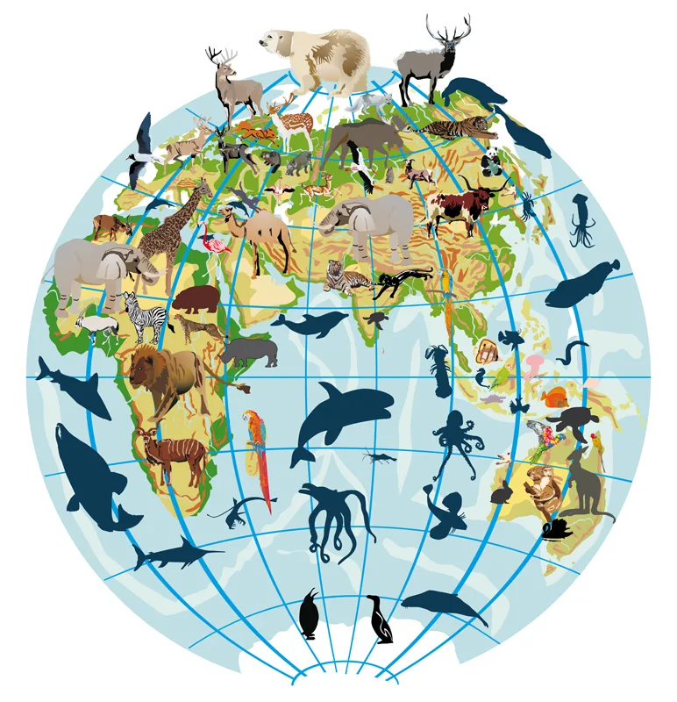
Introduction
Macroecology
&
Biogeography
Notes:
Macroecology
The term macroecology was introduced by Venezuelan scientists Guillermo Sarmiento and Maximina Monasterio in 1971, later popularized by James Brown and Brian Maurer in their 1989 publication *Science*.
Macroecology examines large-scale ecological patterns things like global species richness, geographic range size, and extinction patterns—over very broad spatial and temporal scales. Instead of focusing on interactions between particular species, it looks for general principles that emerge only when we zoom out to global patterns. This approach uses large datasets, statistical models, and comparative methods to understand how climate, land use, productivity, topography, and evolutionary history shape the distribution and abundance of organisms.
In contrast to traditional ecology which often prioritizes direct interactions among species macroecology seeks to identify overarching principles or recurring patterns that are consistent across different continents, ecosystems, and geological time frames.
Biogeography
Biogeography investigates the distribution of species and ecosystems across various geographical spaces and how these patterns have evolved over time. It considers both ecological influences such as climate conditions, habitat availability, and dispersal mechanisms; as well as historical factors including plate tectonics, fluctuations in sea levels, mountain formation processes, glaciation events, and evolutionary lineage.
It draws from data in disciplines including:
Ecology: How the environment affects where species can survive.
Evolutionary Biology: The impact of speciation and extinction on species diversity and variation.
Geology and Paleontology: How events of the past, such as continental drift and glaciations, shape species distributions.
Climatology: How climate and environmental changes affect living organisms.
cites:
– Brodie, J. F., & Mannion, P. D. (2023). The hierarchy of factors predicting the latitudinal diversity gradient
– Macroecology. (n.d.). In Wikipedia. Retrieved December 4, 2025, from https://en.wikipedia.org/wiki/Macroecology
– Biogeography. (n.d.). In Wikipedia. Retrieved December 4, 2025, from https://en.wikipedia.org/wiki/Biogeography

Slide 3
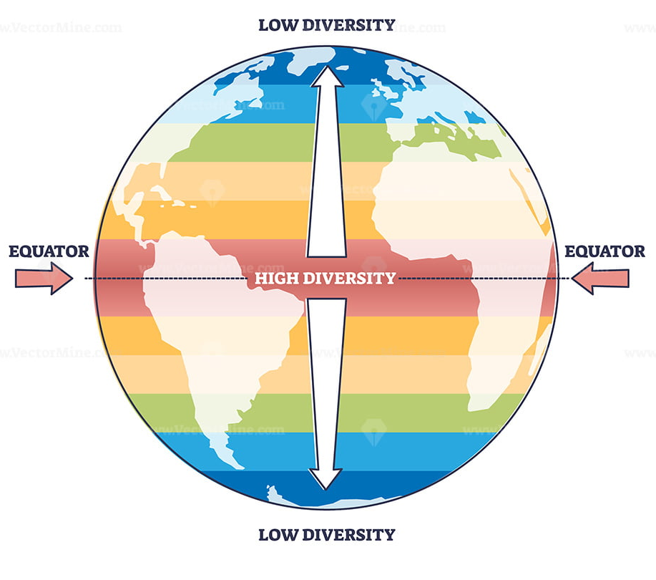
Introductions
Latitudinal Gradients in Biodiversity
Notes:
The latitudinal diversity gradient describes the global pattern in which species richness is highest at low latitudes near the equator and decreases toward the poles. This pattern is remarkably consistent across many groups — vertebrates, invertebrates, plants, microbes, and both marine and terrestrial systems.
“Latitudinal” refers to a location north or south of the equator, “diversity” refers to the number of species, and “gradient” describes the transition from high to low values.
Understanding this pattern matters because biodiversity underpins essential ecosystem functions such as nutrient cycling, productivity, and ecological stability. In addition to species counts, other dimensions of biodiversity — like evolutionary relationships and ecological roles — help us understand how ecosystems respond to environmental change.
Cites:
Introducing the LDG. (n.d.). In Visualizing Life on Earth. UC Museum of Paleontology, University of California, Berkeley. Retrieved December 4, 2025

Slide 4
LDG
• Biodiversity highest at the equator
• Declines toward the poles
• Strong global pattern across taxa
• LDG changed many times through Earth’s history
Brodie & Mannion (2023)
Willig et al. (2003)
Mannion et al. (2014)
Notes:
I’ll begin with the basic pattern we’re studying: the Latitudinal Diversity Gradient.
Most species are found in the tropics, and diversity declines toward the poles.
It’s a classic global pattern, but fossil evidence shows it hasn’t always looked the same.
According to Willig and Brodie & Mannion, the LDG has shifted many times through Earth’s history depending on climate.
So it’s not a fixed rule—it changes when the planet changes.

Slide 5
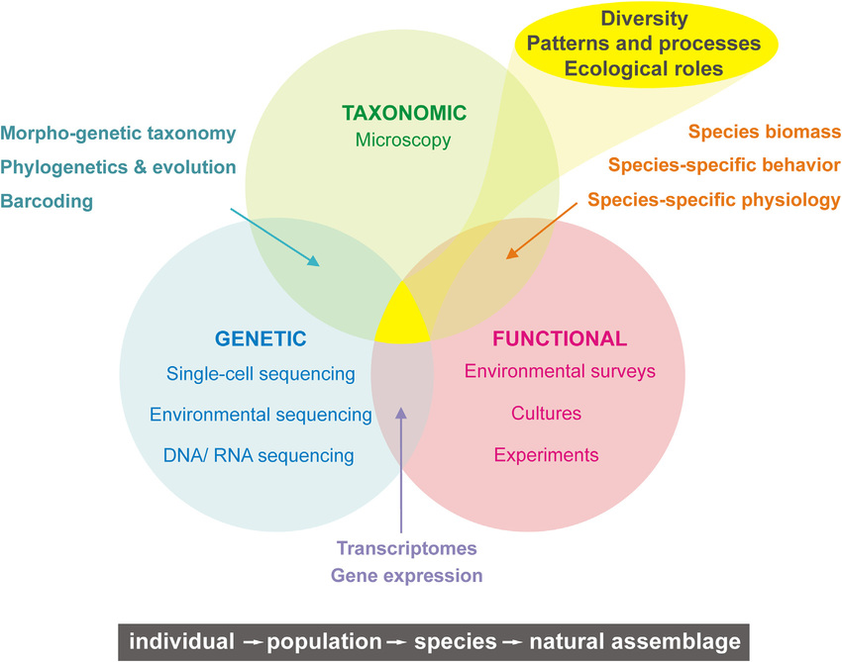
Dimensions of Biodiversity
• Taxonomic: species richness
• Functional: ecological roles
• Phylogenetic: evolutionary lineages
• These dimensions help explain variation in LDG patterns
Brodie & Mannion (2023)
Willig et al. (2003)
Notes:
To understand the LDG, we also need to understand how we measure biodiversity.
We look at three dimensions:
• Taxonomic — number of species
• Functional — what roles those species play
• Phylogenetic — how lineages are related
Together, these help us compare biodiversity across regions and through time, and help explain why the LDG varies.

Slide 6
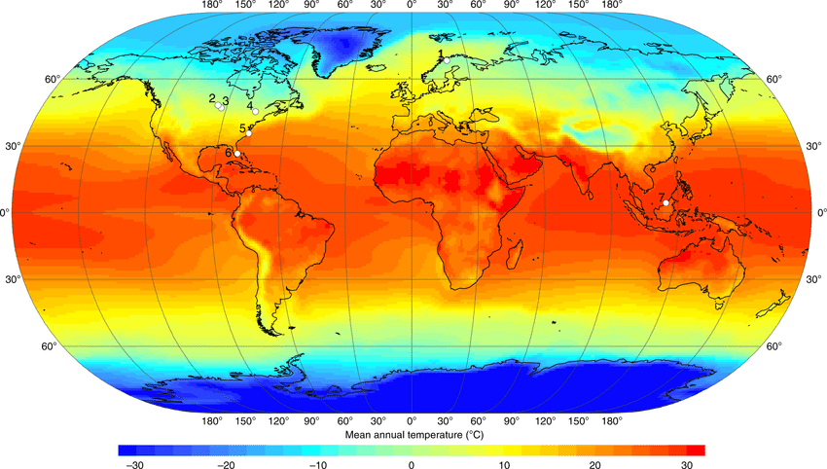
Climate as the Primary Driver
• Coolhouse: strong gradients → tropical peaks
• Warmhouse: weak gradients → flat or temperate peaks
• Energy availability ↑
• Higher diversification rates in warmer climates
• Lower extinction risk in stable warm climates
Brown et al. (2004) Brodie & Mannion (2023)
Mannion et al. (2014)
Notes:
Climate is the main driver of the LDG over long time periods.
During coolhouse climates, strong temperature gradients create high tropical diversity.
But in warmhouse climates, gradients are weak, and diversity can peak in temperate regions instead.
Climate controls energy availability, diversification rates, and extinction risk—so it has a huge impact on where species can thrive.

Slide 7
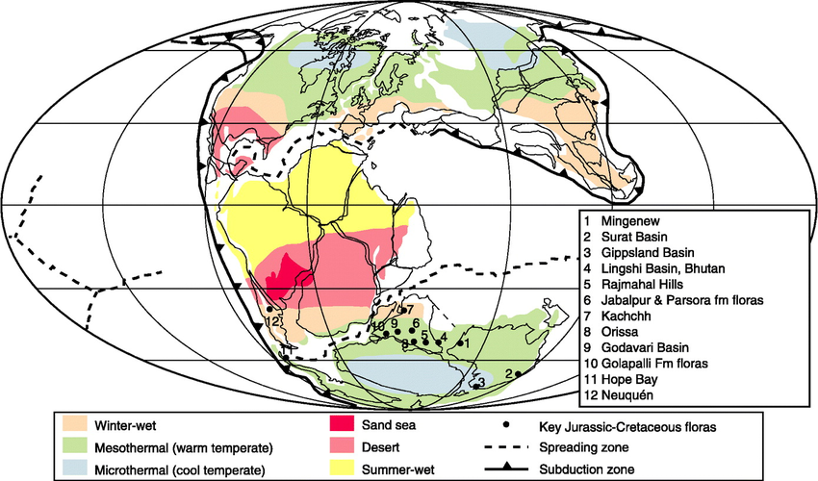
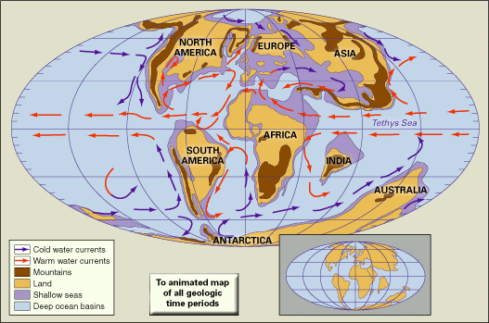
Habitat Area as Secondary Driver
• When climate gradients weaken, habitat area determines where diversity peaks
• Large tropics (Mesozoic) → high tropical diversity
• Large temperate land (Neogene) → temperate peaks
• Biodiversity follows available habitat
Marcot etl al. (2016)
Brodie & Mannion (2023)
Notes:
When climate differences shrink, habitat area becomes the key factor.
For example, in the Mesozoic, the warm and tropical belts were very large.
More space meant more species could evolve and persist in those zones.
In the Neogene, temperate land expanded, and this shifted the diversity peak toward temperate regions.
So diversity often follows whichever climate zone has the most available habitat.

Slide 8
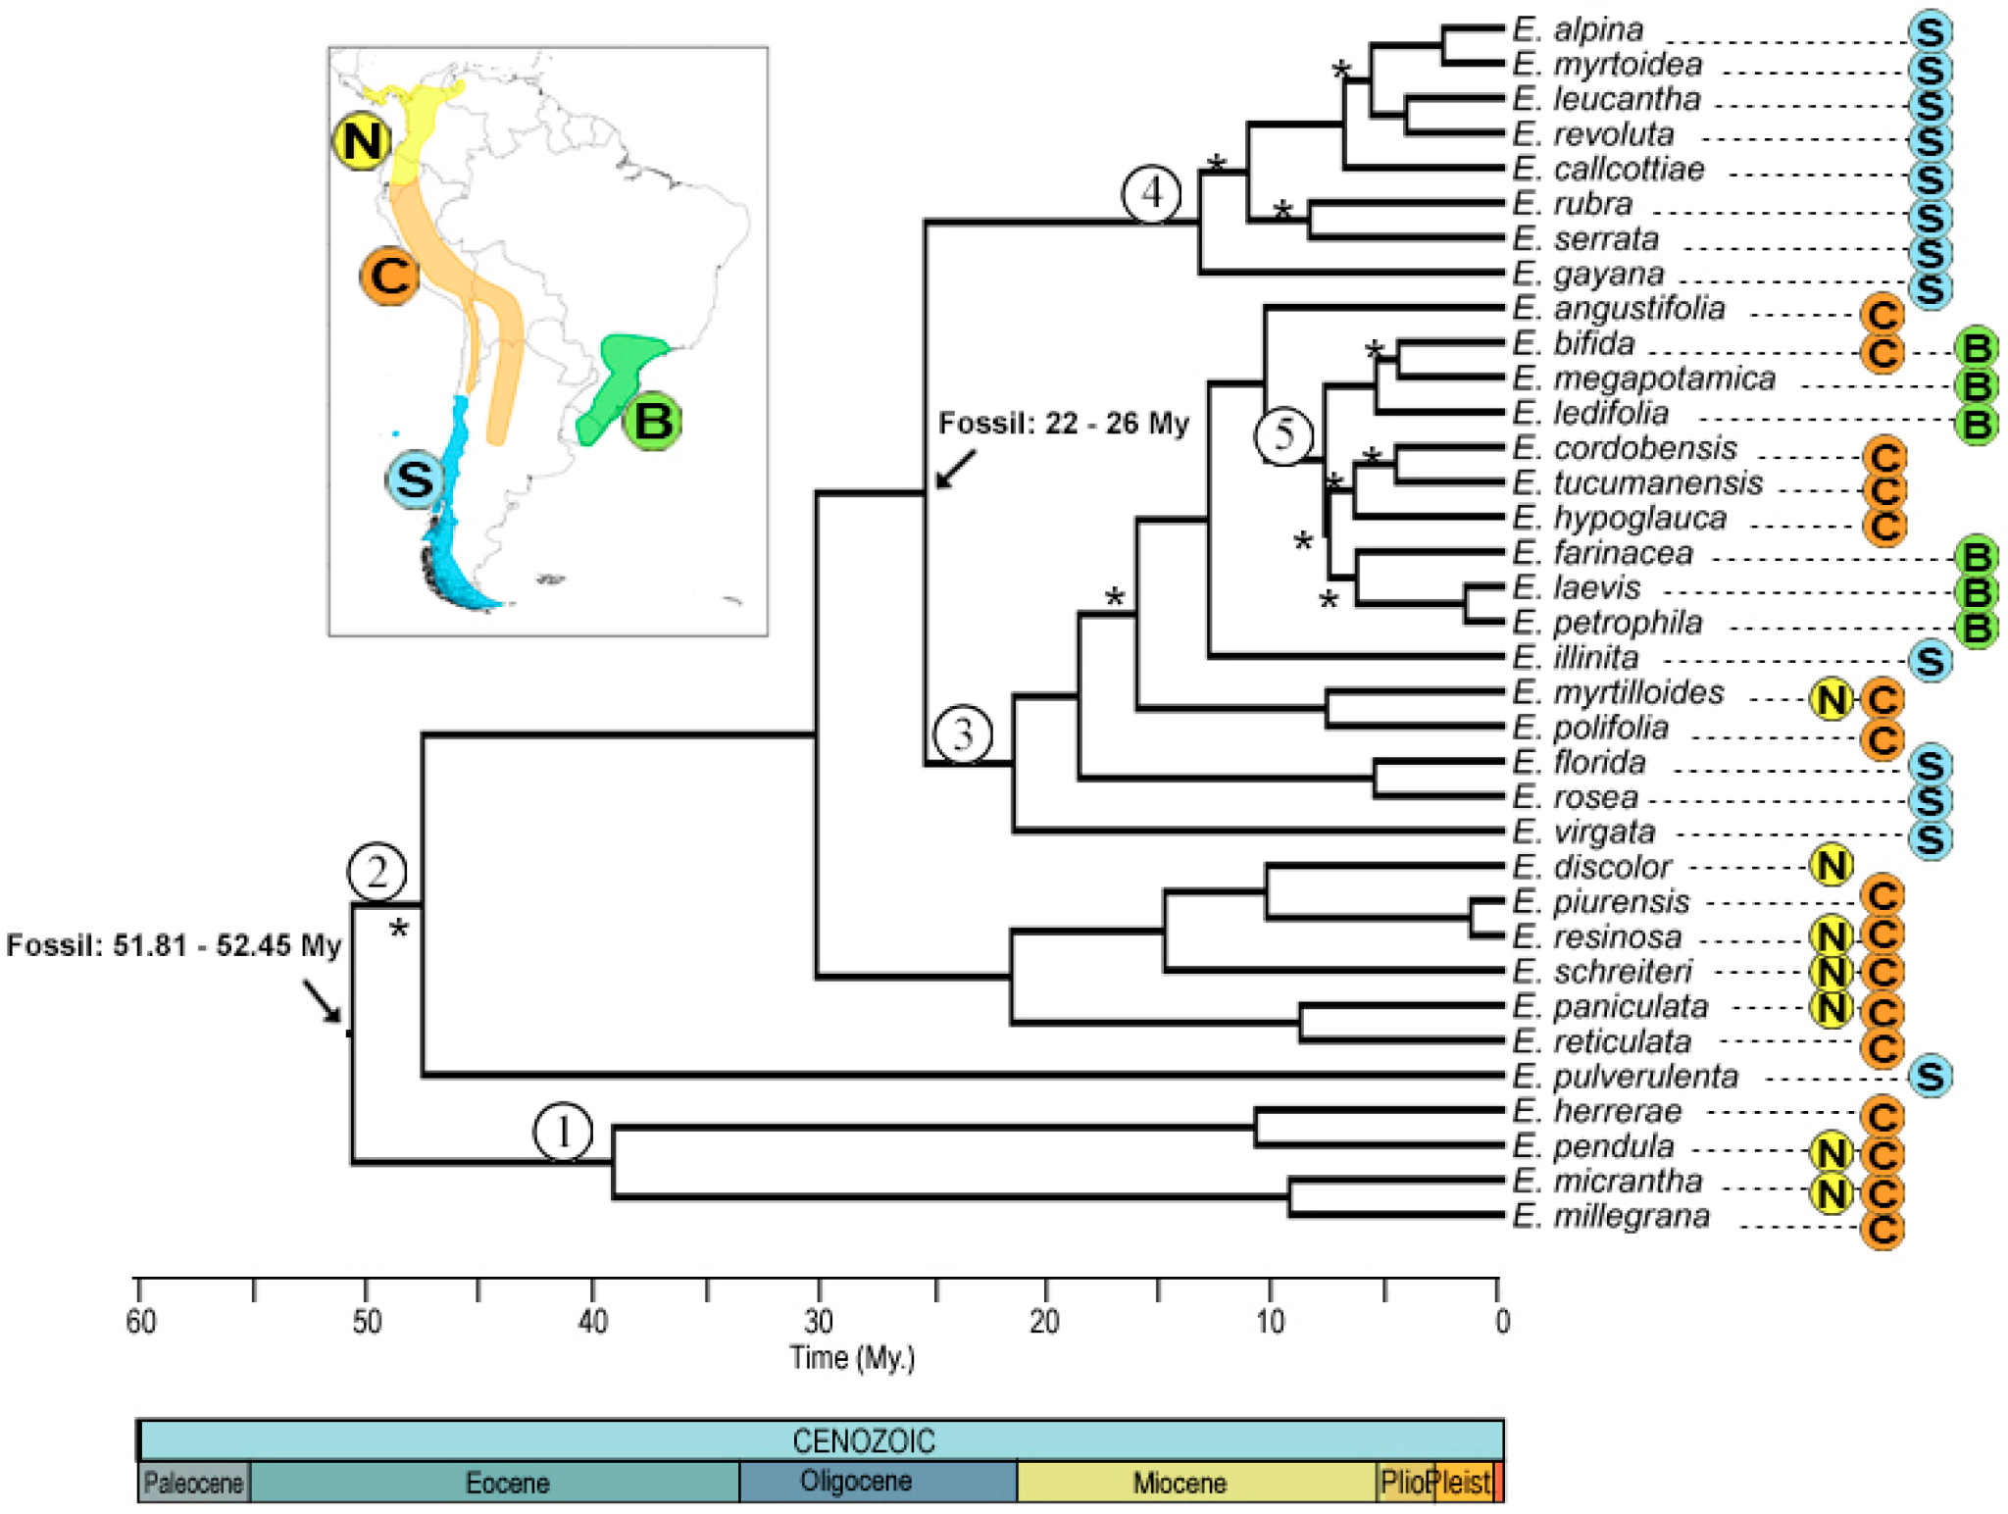
Historical Legacies / Niche Conservatism
• Lineages inherit climate preferences
• Tropically evolved groups stay in warm climates
• Explains short-term patterns
• Weak influence over millions of years
Brodie & Mannion (2023)
Jablonski et al. (2006)
Notes:
Lineages also inherit climate preferences from their ancestors.
Warm-adapted groups usually stay in warm climates, and cold-adapted groups stay in cold ones.
This explains short-term patterns, but over millions of years it’s a weaker factor compared to climate and habitat area.

Slide 9
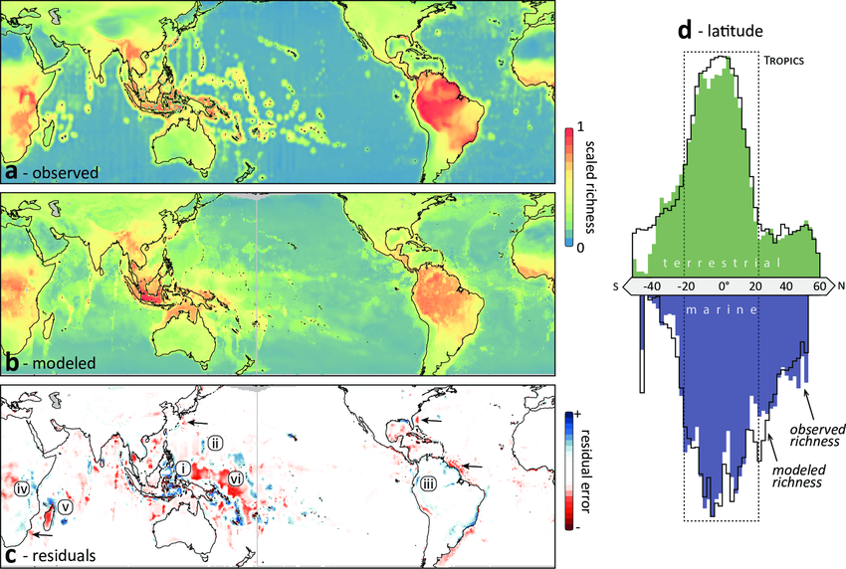
Exceptions to LDG
• Fossil sampling problems
• Extreme climate events
• Taxonomic differences
• Marine vs terrestrial contrasts
• Some groups show reversed LDG patterns
Brodie & Mannion (2023)
Mannion et al. (2014)
Willig et al. (2003)
Notes:
Even though the LDG is strong, there are important exceptions.
Some come from fossil sampling biases, extreme climate events, or differences between groups.
Marine systems, for example, sometimes show the opposite pattern—higher diversity away from the tropics.
These exceptions remind us that the LDG is widespread but not universal.

Slide 10
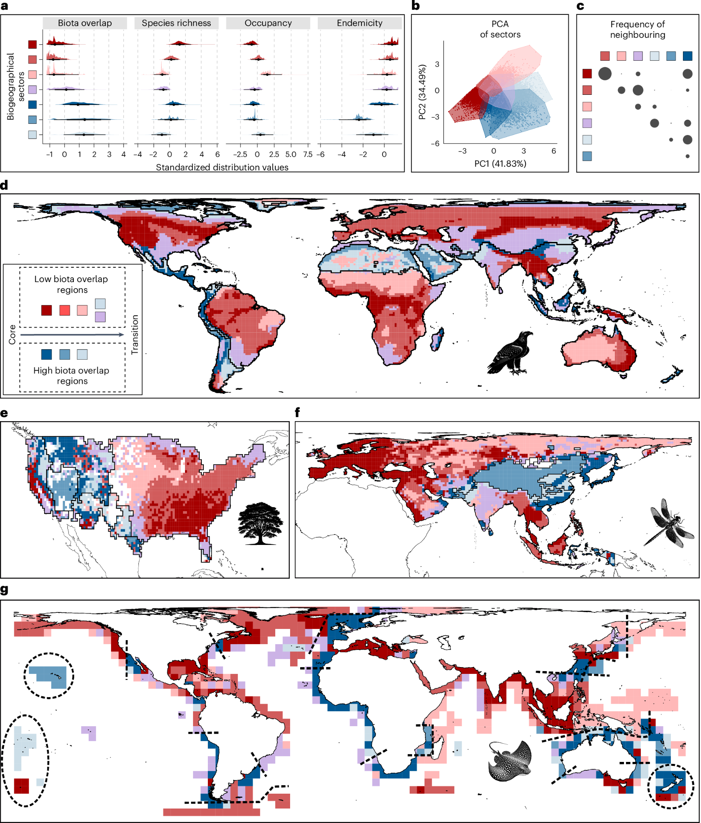
Willig, Kaufman, & Stevens (2003):
“Latitudinal gradients of biodiversity: pattern, process, scale, and synthesis”
Willig, Kaufman, & Stevens (2003):
Findings
Notes:
No single mechanism explains the LDG; rather likely a combination of factors acting at different scales
LDG not exclusively terrestrial: exists in marine, freshwater, parasitic systems.
Exceptions exist: certain groups (parasitic wasps, aquatic plants, seals) display inverse gradients that peak in temperate zones
They confirmed that the LDG is the most consistent pattern in life. It holds for:
Plants: trees, mangroves, vascular plants
Vertebrates: mammals (bats, rodents, carnivores), birds, reptiles, amphibians
Invertebrates: corals, termites, ants
Shape: noted that the gradient isn't always a straight line (linear) from pole to equator - often plateaus in the tropics
Asymmetry: found that the gradient is often not perfectly symmetrical between the Northern and Southern hemispheres (largely because the landmasses are different shapes)
Exceptions: ("inverse" gradient): they honestly reported the outliers
Parasitic wasps: actually display more diversity in temperate zones, the hypothesis being that in the tropics, host caterpillars are rarer/harder to find due to predation, or that pupae rot sooner in hotter climates
Aquatic macrophytes: the diversity of some aquatic plants peaks in temperate zones because apparently tropical waters can prove too warm or nutrient-poor for them
Penguins & pinnipeds: these groups are adapted to cold temperatures, allowing for a reverse gradient
So: the pattern is robust, but it is not a "law of physics”. it is a biological tendency with biological exceptions
Abiotic hypotheses:
Species-Energy Hypothesis: Solar energy + Water = Primary Productivity (plants). More plants mean more food (biomass), which supports larger populations. Larger populations are less likely to go extinct. (Mechanism: Energy → Biomass → Population Size → Reduced Extinction)
Climate Stability: The tropics have been stable for millions of years (no glaciers). Temperate zones are frequently "reset" by ice ages. Stability allows specialization; instability forces organisms to be "jacks-of-all-trades" (generalists), which prevents speciation.
Environmental Harshness: Cold or dry environments require complex physiological adaptations (like antifreeze proteins). Evolution is hard; few species manage to solve these "problems," so few species live there.
Biotic Hypotheses (Interactions)
These theories suggest that life creates more life.
Predation: Intense predation in the tropics prevents any one species from dominating (monopolizing resources). Because of this,there is room for many rare species to coexist.
Niche Specialization: Because the tropical climate is stable, species can afford to have very narrow niches (e.g., eating only one type of fig). If everyone eats a tiny slice of the pie, you can fit more people at the table.
The Geometric Hypothesis:
The LDG might not be biological at all. It might be a statistical artifact of "geometric constraints." Willig et al. argued that while MDE (mid-domain effect) explains some of the pattern, it fails to explain the steepness of the tropical peak. Biology must be adding to the geometry.

Slide 11
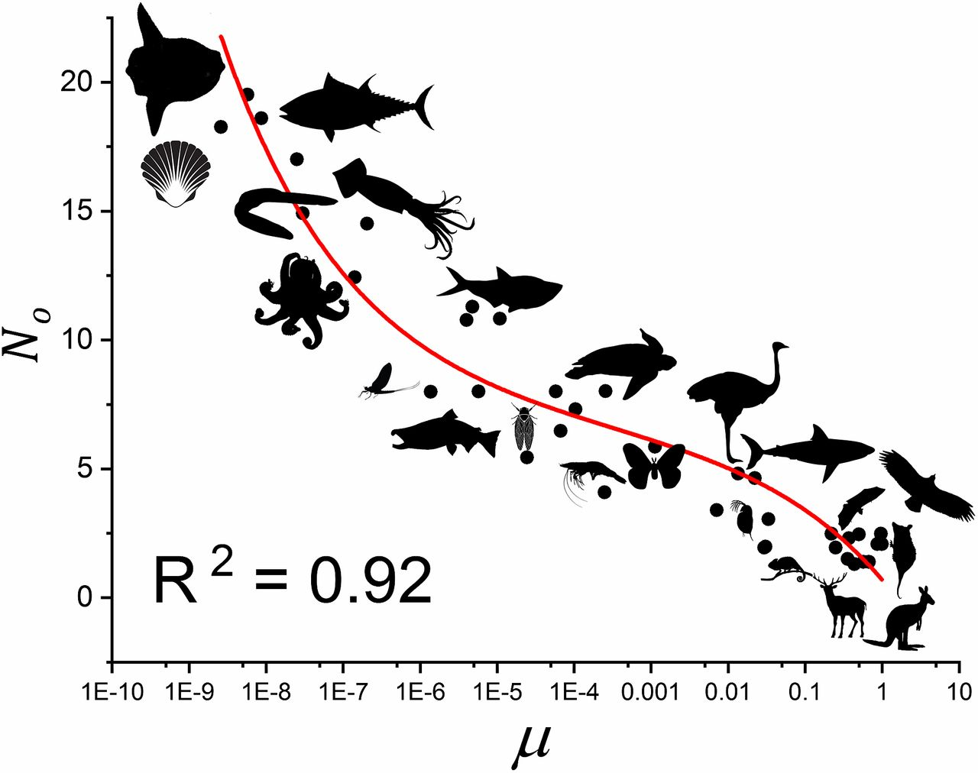
Supporting literature for Willig et al.
Brown, J. H., et al. (2004). “Toward a metabolic theory of ecology.” Ecology.
Notes:
Formalized the idea that temperature - metabolism - diversity
Proposes a mathematical equation intended to predict how ecological rates are controlled by temperature
Supports the “abiotic” hypotheses in Willig et al., and suggests a potential mechanism to explain why temperature leads to more species (faster mutations and generational turnover)

Slide 12
Willig, Kaufman, & Stevens (2003):
“Latitudinal gradients of biodiversity: pattern, process, scale, and synthesis”
Limitations
Notes:
A meta-analysis (a study of other studies) that inherits the flaws of the data available at the time
Relies on correlative studies: identifies where pattern happens, but not how, and cannot distinguish between a direct vs. indirect cause
Reviewed studies that varied wildly in their measurement of diversity (some measured 1m^2 plots, others measured entire countries) —-> creates statistical noise
Exclusively looks at living species = neontological bias

Slide 13
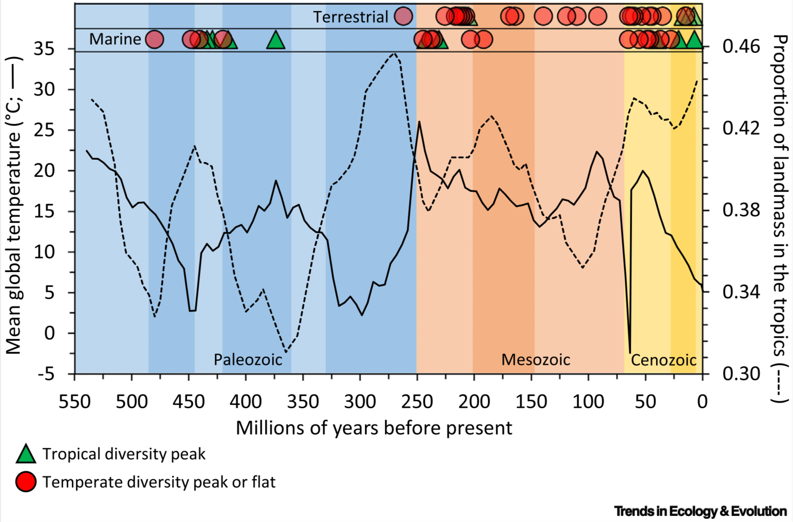
Brodie & Mannion (2023)
“The hierarchy of factors predicting the latitudinal diversity gradient”
Findings:
LDG not a fixed rule, but a climate-dependent dynamic state with a hierarchy of drivers
Image from this paper: “reconstructed latitudinal diversity gradients (LDGs), accounting for taphonomic and sampling biases, throughout the Phanerozoic”
Notes:
From most to least important:
Climate: over long timescales main predictor is temperature, warmer world=wider biodiversity bands
Area: if shallow gradient (e.g., whole world is warm), then area^2 of livable habitat determines diversity
Lineage history: if a lineage evolved in a given climate, it tends to remain there (however, Historical legacies rarely shape global LDGs for more than hundreds of thousands to a few million years. they don’t explain the greater LDG patterns that we see over tens of millions of years.)
The authors take into account the broader history of life on Earth, noting that for much of Earth’s history (such as in the especially hot Mesozoic) the LDG was much flatter, with peak diversity sometimes occurring in northern latitudes (as opposed to the tropical diversity peak we see in the relatively cooler global climate of today’s Earth)

Slide 14
Brodie & Mannion (2023)
“The hierarchy of factors predicting the latitudinal diversity gradient”
Limitations:
Draws from data with a limited scope
Uses uncertain statistical methods to correct for recency bias
Notes:
Often draws from marine data which may not always apply to animals of different biomes
Uses often uncertain statistical corrections to account for recency bias in analysis of biodiversity in the fossil record vs. modern times (modern diversity can appear higher because newer fossils haven’t yet been destroyed by geological processes)
Links biodiversity to past temperatures (which are estimates based on oxygen isotopes) —-> generally accurate but with margins of error that can alter interpretations of the relationship between diversity and climate

Slide 15
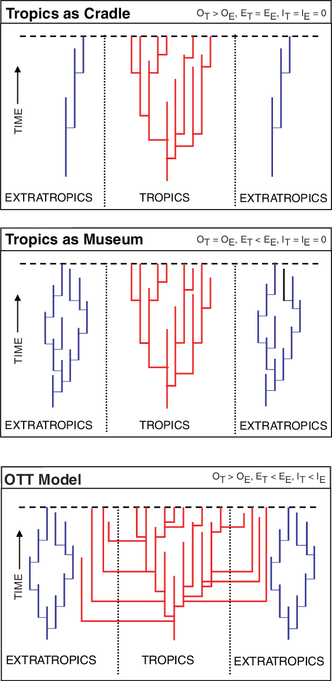
Supporting literature for Brodie & Mannion
Jablonski, D., Roy, K., & Valentine, J. W. (2006). “Out of the tropics: evolutionary dynamics of the latitudinal diversity gradient.” Science.
Explains the biological process that creates the gradients described by Brodie & Mannion
Showed that tropics are a biodiversity cradle (species originate there), a species pump (contains species that leave tropics and radiate towards poles) and a museum (extinction rate is lower there)
Notes:
by 2006, the general consensus on the LDG had settled on a two choices re: the mechanism:
Cradle hypothesis: The tropics have a high rate of species “origination”. New species arise there, but might die off at a similar rate
Museum hypothesis: The tropics have lower extinction rates. New species arise everywhere, but the stability of a tropical climate aspire allows for their continued survival for millions of years, creating an accumulation of biodiversity
Jablonski et al. realized that looking at a static map (like Willig) wasn’t sufficient. They thought it necessary to see where species started and the moved
To solve this, they chose to examine: marine bivalves (clams, oysters, scallops) due to their reliable presence in the fossil record (bivalves are ideal because of their hard, well-fossilizing shells, they can also be found at all latitudes and have a standardized taxonomy).They examined the fossil history of the last 11 million years of bivalve evolution, the location of the first appearance of each genus, and the ways in which their geographic ranges have shifted over millions of years.
Their analysis invalidated the binary debate: they found that the tropics are not exclusively a cradle or a museum; they are also a pump.
some 75% of all bivalve genera that arose in the last 11 million years originated in a tropical climate
Movement: once these genera evolve in the tropics, they do not always stay there: they radiate toward the poles. they do not “leave” the tropics but rather stay in the tropics while their conspecifics simultaneously colonize temperate zones.
Asymmetry: the reverse of this process is rare: exceedingly few lineages originate in temperate zones and then radiate into tropical climes.
Conclusion: Earth’s tropical belt is the primary origin point of global biodiversity. The temperate zone is a ‘colony’ populated by immigrants from the tropics.

Slide 16
Supporting literature for Brodie & Mannion
Jablonski, D., Roy, K., & Valentine, J. W. (2006). “Out of the tropics: evolutionary dynamics of the latitudinal diversity gradient.” Science.
Explains the biological process that creates the gradients described by Brodie & Mannion
Showed that tropics are a biodiversity cradle (species originate there), a species pump (contains species that leave tropics and radiate towards poles) and a museum (extinction rate is lower there)
Notes:
by 2006, the general consensus on the LDG had settled on a two choices re: the mechanism:
Cradle hypothesis: The tropics have a high rate of species “origination”. New species arise there, but might die off at a similar rate
Museum hypothesis: The tropics have lower extinction rates. New species arise everywhere, but the stability of a tropical climate aspire allows for their continued survival for millions of years, creating an accumulation of biodiversity
Jablonski et al. realized that looking at a static map (like Willig) wasn’t sufficient. They thought it necessary to see where species started and the moved
To solve this, they chose to examine: marine bivalves (clams, oysters, scallops) due to their reliable presence in the fossil record (bivalves are ideal because of their hard, well-fossilizing shells, they can also be found at all latitudes and have a standardized taxonomy).They examined the fossil history of the last 11 million years of bivalve evolution, the location of the first appearance of each genus, and the ways in which their geographic ranges have shifted over millions of years.
Their analysis invalidated the binary debate: they found that the tropics are not exclusively a cradle or a museum; they are also a pump.
some 75% of all bivalve genera that arose in the last 11 million years originated in a tropical climate
Movement: once these genera evolve in the tropics, they do not always stay there: they radiate toward the poles. they do not “leave” the tropics but rather stay in the tropics while their conspecifics simultaneously colonize temperate zones.
Asymmetry: the reverse of this process is rare: exceedingly few lineages originate in temperate zones and then radiate into tropical climes.
Conclusion: Earth’s tropical belt is the primary origin point of global biodiversity. The temperate zone is a ‘colony’ populated by immigrants from the tropical zone.

Slide 17
Supporting literature for Brodie & Mannion
Jablonski, D., Roy, K., & Valentine, J. W. (2006). “Out of the tropics: evolutionary dynamics of the latitudinal diversity gradient.” Science.
Explains the biological process that creates the gradients described by Brodie & Mannion
Showed that tropics are a biodiversity cradle (species originate there), a species pump (contains species that leave tropics and radiate towards poles) and a museum (extinction rate is lower there)
Notes:
by 2006, the general consensus on the LDG had settled on a two choices re: the mechanism:
Cradle hypothesis: The tropics have a high rate of species “origination”. New species arise there, but might die off at a similar rate
Museum hypothesis: The tropics have lower extinction rates. New species arise everywhere, but the stability of a tropical climate aspire allows for their continued survival for millions of years, creating an accumulation of biodiversity
Jablonski et al. realized that looking at a static map (like Willig) wasn’t sufficient. They thought it necessary to see where species started and the moved
To solve this, they chose to examine: marine bivalves (clams, oysters, scallops) due to their reliable presence in the fossil record (bivalves are ideal because of their hard, well-fossilizing shells, they can also be found at all latitudes and have a standardized taxonomy).They examined the fossil history of the last 11 million years of bivalve evolution, the location of the first appearance of each genus, and the ways in which their geographic ranges have shifted over millions of years.
Their analysis invalidated the binary debate: they found that the tropics are not exclusively a cradle or a museum; they are also a pump.
some 75% of all bivalve genera that arose in the last 11 million years originated in a tropical climate
Movement: once these genera evolve in the tropics, they do not always stay there: they radiate toward the poles. they do not “leave” the tropics but rather stay in the tropics while their conspecifics simultaneously colonize temperate zones.
Asymmetry: the reverse of this process is rare: exceedingly few lineages originate in temperate zones and then radiate into tropical climes.
Conclusion: Earth’s tropical belt is the primary origin point of global biodiversity. The temperate zone is a ‘colony’ populated by immigrants from the tropical zone.

Slide 18
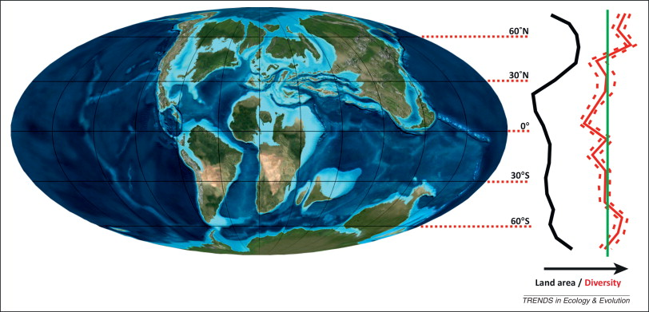
Supporting literature for Brodie & Mannion
Mannion, P. D., et al. (2014). “The latitudinal biodiversity gradient through deep time.” Trends in Ecology & Evolution.
This image depicts the Earth as it appeared in the Late Cretaceous, and the accompanying graph describes the latitudinal diversity gradient for dinosaurs as it is hypothesized to have appeared in that time period. Dinosaur diversity peaked in temperate climates.
Notes:
Direct predecessor of the 2023 Brodie & Mannion paper that contrasts “icehouse” worlds (e.g., modern Earth: steep diversity gradients) with “greenhouse” worlds (e.g., Cretaceous earth: flat diversity gradients)
Supports claim that the LDG is not a fixed law of nature, proves that the gradient was flat for millions of years with palaeontological data
for much of the Mesozoic, the tropics were vast → land area alone facilitated tropical diversity
Their analysis of the Phanerozoic (the last 541 million years) revealed that the "tropical peak" is actually rare.
Icehouse pattern: steep gradient with a tropical peak and sheep declines near the poles (such as in the Holocene) because strong temperature gradients from pole to equator create distinct climatic bands, restricting species to the warm tropics
Greenhouse pattern: flattened gradients or temperate peaks (such as in the Cretaceous, in which dinosaur diversity peaked in temperate zones, or the Eocene, in which temperate Canada had insect diversity comparable to modern Costa Rica) because in a warm world, the "tropics" expand to the poles. Animals aren't trapped at the equator by cold polar caps, so they spread out

Slide 19
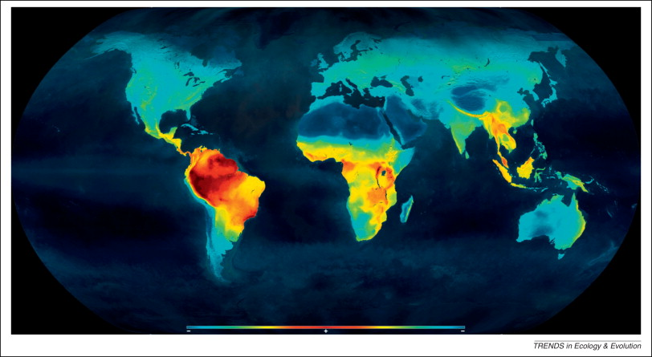
Supporting literature for Brodie & Mannion
Mannion, P. D., et al. (2014). “The latitudinal biodiversity gradient through deep time.” Trends in Ecology & Evolution.
This image depicts the latitudinal biodiversity gradient as it appears in the modern day, with a narrow band near the equator.
Notes:
The current epoch (Holocene) has been characterized by a comparatively cool global climate, with ice caps and a narrow band of tropical climate near the equator. Biodiversity is concentrated in this area.
Proposes several reasons why the gradient changes shape, foreshadowing the "Hierarchy" in the 2023 paper:
Temperature & extinction: In "greenhouse" worlds, the tropics might get too hot (lethally hot temperatures >40°C), causing extinctions at the equator and forcing migrations into temperate zones
Area: Highlights that land area matters. In the Cretaceous, there was simply more land in the temperate zones than the tropics. Because the climate was warm everywhere, dinosaurs followed the land, not the sun
Seasonality: suggests that seasonality (the difference between summer and winter) might be more important than raw temperature. The tropics are "aseasonal" (stable). In the past, if the temperate zones became less seasonal (more stable), they could support typically tropical-levels of diversity

Slide 20
Comparison of methodology and findings
Willig et al.:
Approach the subject through a neontological lens (studying extant organisms)
Aim to describe the pattern
View the LDG as a general rule of thumb
Brodie & Mannion:
Take into account paleontological data
Aim to explain why the pattern varies over long timescales
View the LDG as resultant of Earth’s relatively cool current climate
Notes:
Willig et al.:
Biggest strength: Breadth. This paper analyzes a massive diversity of life forms.
Biggest weakness: Static. They treat the gradient as a fixed pattern.
Methodology: inductive. Gathers data and observes any patterns within.
Risk: Confounding variables could create false positives
Brodie & Mannion:
Biggest strength: Depth. Looks at how the pattern evolves over millions of years.
Biggest weakness: incomplete data. The fossil record is inherently sparse.
Methodology: Deductive. Begins with an assumption that climate drives rates, and checks if the fossil record supports that.
Risk: poor preservation of fossils could lead to the potentially false conclusion that a species was absent from an area.

Slide 21
WHY LDG IS IMPORTANT???
(1)GENETICS AND EVOLUTION
LDG patterns reveal how biodiversity varies with latitude and environmental linking to genetic and phylogenetic diversity to species evolution.
(2)BIODIVERSITY CONSERVATION
It supports conservation by identifying areas rich in species and genetic diversity that need protection.
WHY LDG CHANGE OVER TIMES?
(1) climate change , (2) human activity (3) continental drift (4) evolution and extinction
HOW DO LDG SAMPLES COLLECT.?
LDG samples can collect from (1) ecology and evolution (2) genetics and genomics
Most LDG samples get from ecology and evolution
Less LDG samples get from genetics and genomics

Slide 22
Conclusion
Brodie & Mannion (2023) present the more robust, durable analysis because they treat the Latitudinal Diversity Gradient as a dynamic evolutionary outcome, as opposed to the unchanging ecological law envisioned by Willig et al. (2003). Willig’s analysis holds a fundamental limitation in its neontological bias: trying to explain a deep-time phenomenon using only a snapshot of the modern world, conflating the modern "icehouse" climate and its steep gradient with a universal rule of thumb. Brodie's hierarchy of driving factors (in which temperature drives diversity over time, but area takes over when gradients flatten) appears superior because it successfully predicts “exceptions” such as Mesozoic temperate diversity peaks.
Notes:
Brodie & Mannion (2023) present the more robust, durable analysis because they treat the Latitudinal Diversity Gradient (LDG) as a dynamic evolutionary outcome, as opposed to the unchanging ecological law envisioned by Willig et al. (2003). Willig’s analysis holds a fundamental limitation in its neontological bias: trying to explain a deep-time phenomenon using only a snapshot of the modern world, conflating the modern "icehouse" climate and its steep gradient with a universal rule of thumb. Brodie's hierarchy of driving factors (in which temperature drives diversity over time, but area takes over when gradients flatten) appears superior because it successfully predicts “exceptions” such as Mesozoic temperate diversity peaks. Supporting this conclusion is fossil evidence (Mannion et al., 2014) and ex-tropical migration dynamics (Jablonski et al., 2006). It must be noted that Willig's insistence on scale-dependence remains a critical truth of macroecology. While Brodie & Mannion dissect the evolutionary reasons and timeframes on a global scale, Willig’s arguments concerning geometric constraints and biotic interactions continue to accurately describe the locales of current diversity.

Slide 23
Conclusion
Supporting this conclusion is fossil evidence (Mannion et al., 2014) and ex-tropical migration dynamics (Jablonski et al., 2006). It must be noted that Willig's insistence on scale-dependence remains a critical truth of macroecology. While Brodie & Mannion dissect the evolutionary reasons and timeframes on a global scale, Willig’s arguments concerning geometric constraints and biotic interactions continue to accurately describe the locales of current diversity.

Slide 24
Macroecology and Biogeography
Varinka Pastrana Jessel – Introduction and organization
Mahmud Gurbanzade – Main concepts
Nate Harrison – Paper analysis
San Khin Chuu – Conclusions

Slide 25
Citations:
Related literature:
Willig, M. R., Kaufman, D. M., & Stevens, R. D. (2003). Latitudinal gradients of biodiversity: pattern, process, scale, and synthesis. Annual review of ecology, evolution, and systematics, 34(1), 273-309.
Brodie, J. F., & Mannion, P. D. (2023). The hierarchy of factors predicting the latitudinal diversity gradient. Trends in Ecology & Evolution, 38(1), 15-23.
Colwell, R. K., & Lees, D. C. (2000). The mid-domain effect: geometric constraints on the geography of species richness. Trends in Ecology & Evolution.
Brown, J. H., et al. (2004). Toward a metabolic theory of ecology. Ecology.
Jablonski, D., Roy, K., & Valentine, J. W. (2006). Out of the tropics: evolutionary dynamics of the latitudinal diversity gradient. Science.
- Mannion, P. D., et al. (2014). The latitudinal biodiversity gradient through deep time. Trends in Ecology & Evolution.
Mittelbach, G. G., et al. (2007). Evolution and the latitudinal diversity gradient: speciation, extinction and biogeography. Ecology Letters.

